Slide 1

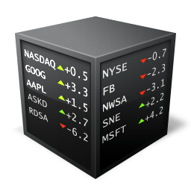
Subreddit Post Text Pattern
r/stocks and r/CryptoCurrency
A binary text classification project
By Natasha

Slide 2
1
Background
As a part of marketing division of an investment club, we would like to create a list of suggested post/news based on comments left by user in the discussion thread. This enables us to create a curated content that suits our member's interest
Data of Interest: People tend to discuss and share their analysis before making any trade.
Reddit is a platform to have an open discussion on many topics
A broad topic can be categorized to a subreddit where people can share their thoughts, ask questions or opinions from others and user anonymity is guaranteed in this platform

Slide 3
2
Subreddits
From the beginning of COVID, people shows significant interest on how to grow their money. There are many investment instruments to do so such as stock and crypto currency.
There are many differences among them, but while discussing these topics, the words used is quite similar.

Slide 4
3
Problem Statement
Creating a model to do binary text classification (stocks/ CryptoCurrency) based on the post where the model then can be implemented to classify member's discussion thread.
The goal of our model is to get a good degree of separation between the two classes which is represented by Receiver Operating Characteristics Area Under the Curve (ROC-AUC).
- The higher it is, the better the model at predicting the binary class.

Slide 5
Introduction
Analysis on text pattern on r/stocks and r/CryptoCurrency
Subreddit Post First Outlook
What similarities or differences we can observe from EDA?
Pre-processing and Exploration
Vectorizer analysis and diving on the modeling
Summary
What is wrong and how can it go wrong?

Slide 6
Introduction
r/stocks and r/CryptoCurrency

Slide 7
Methodology
Exploratory Data Analysis
Natural Language Processing Application
What pattern that we can observe?
Hyperparameter tuning for potential model
Data Pre-Processing
Final Model Adjustment
How do we create effective features?
Optimal threshold selection for final model
Subreddit Post Classification
Binary classification from Subreddit post
Scraping
Error Analysis
Using API push shift to pull title and self text from Reddit post
Why did our model predict the wrong class? Is there any limitations or potential improvement for final model?

Slide 8
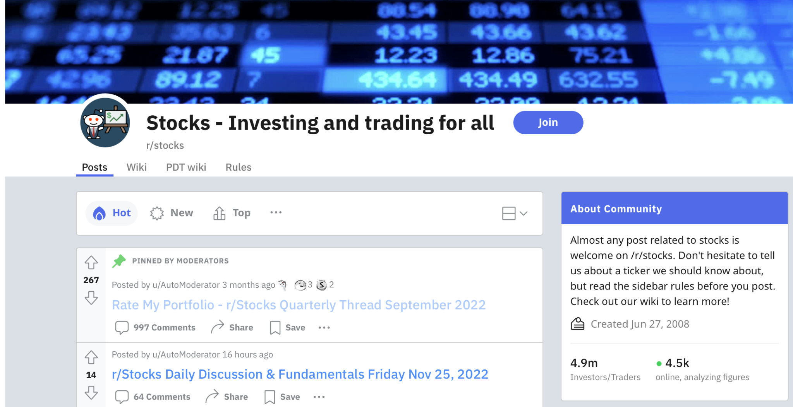

Webscraping
Huge users in both subreddits

Slide 9
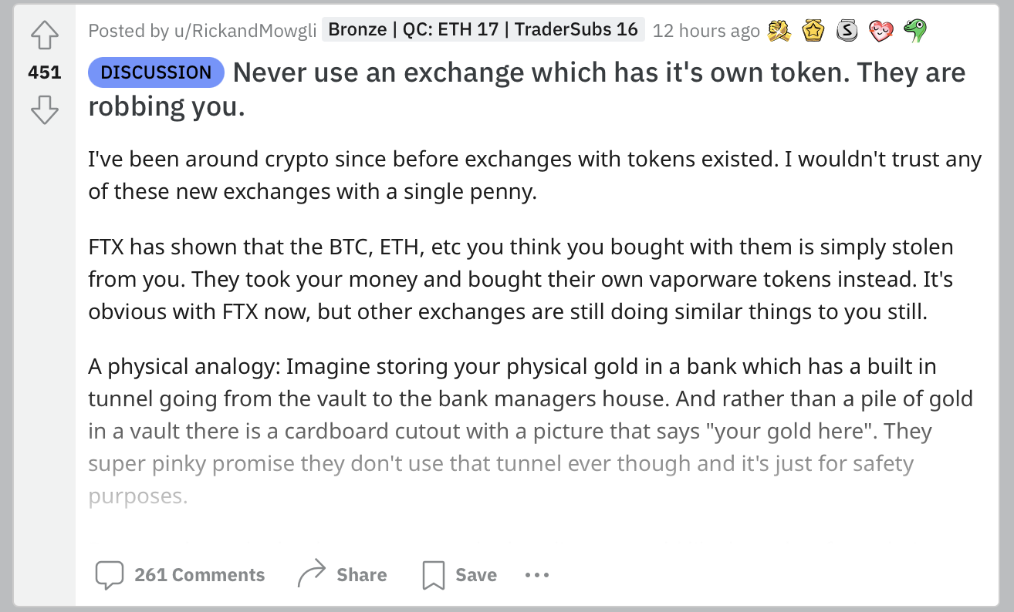
Web-scraping
Title
Self Text
> Scraping through title and self text

Slide 10
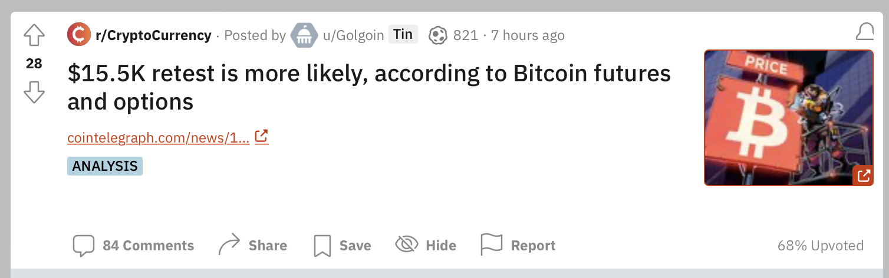
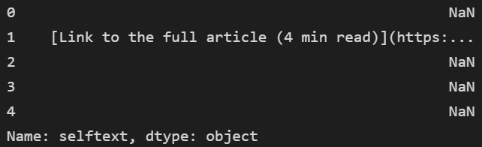
Pre-processing
Lemmatize: “futures” becomes “future”
Contains link
Contains stopwords
Contains punctuations
Post that contains empty selftext post scraping: removed!
Contains number

Slide 11
Subreddit First Outlook (EDA)
r/stocks and r/CryptoCurrency

Slide 12
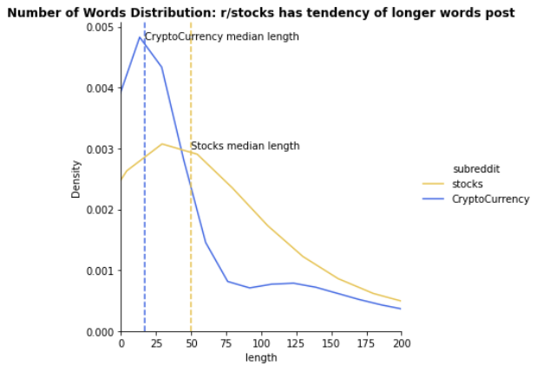
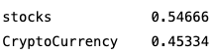
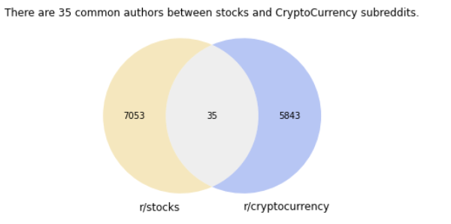
EDA: Post Length and Overlapping User
Balanced Data

Slide 13
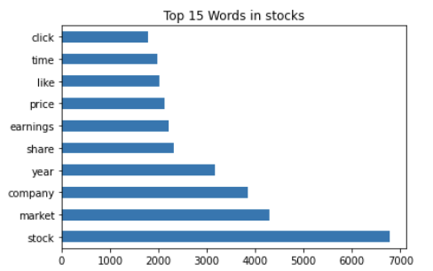
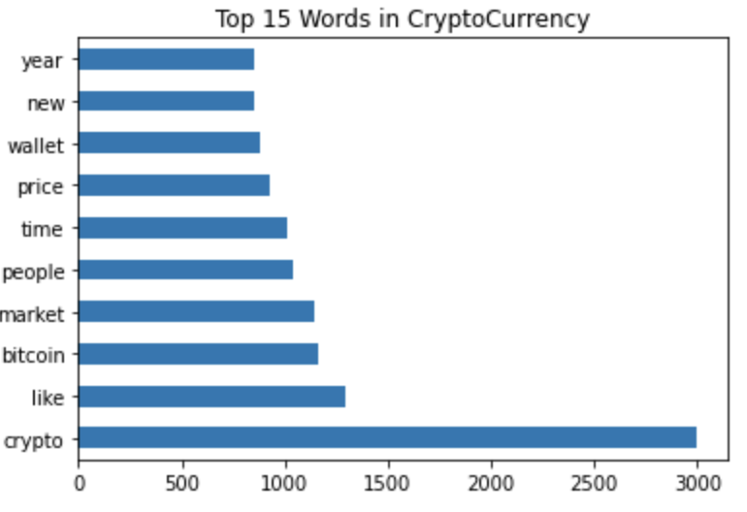
EDA: Overlapping Token
“stock” and “crypto” are the most distinct feature, we will remove them for our model training
“Most of the people and analyst saying market is gonna crash next year, SP500 below 3400,huge recession incoming, terrible earnings etc.
Yes we may get a bit higher unemploymet(3.8-4.2%), earnings will maybe have a miss but nothing too devastating, economy still strong throughout 2023. How things are going, we might achieve soft landing.
Your opinion?”
“For those unfamiliar, CZ (will admit like 90% of you I can't say his real name right) is the leader of the largest crypto exchange and pretty much an indirect reason why the market has tumbled further. He sped up the process of outing Sam and helped collapse FTX which we all know the rest…
Turns out it was BS. Coinbase has pretty much revealed they may as well rename themselves BTC incorporated as they absolutely dwarf Binance in Btc reserves. Moral of the story, there are lots of people trying to create FUD and looking to further shake out retailers. CZ is now a living meme”

Slide 14
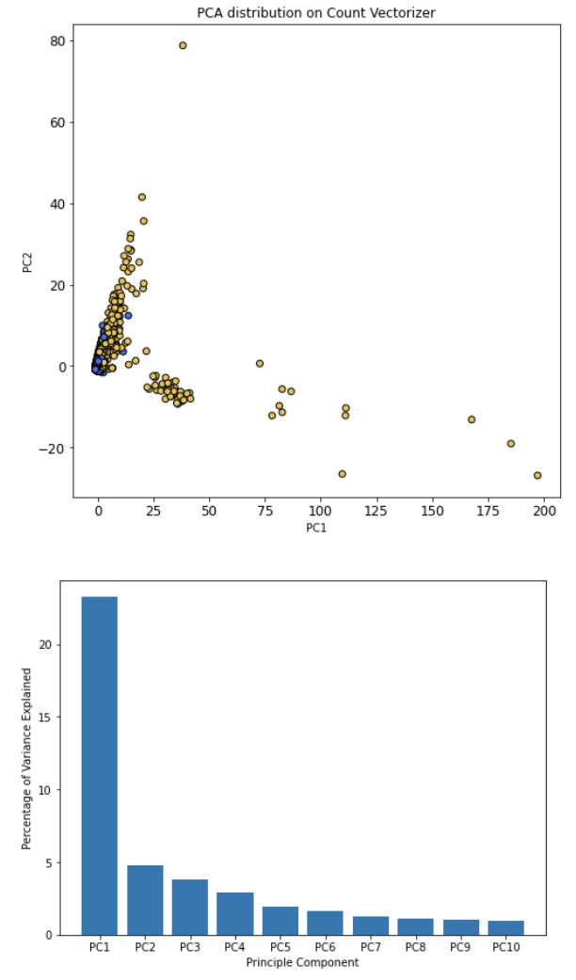
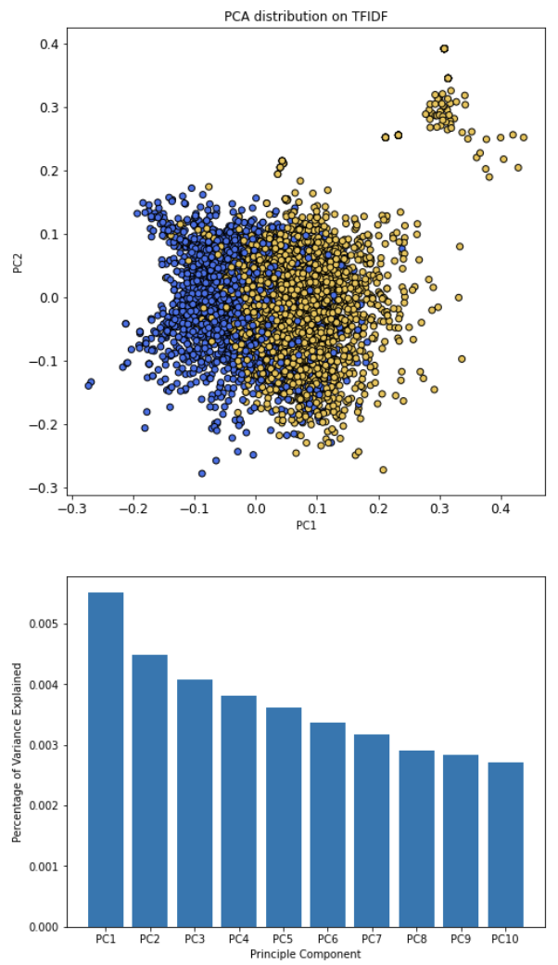
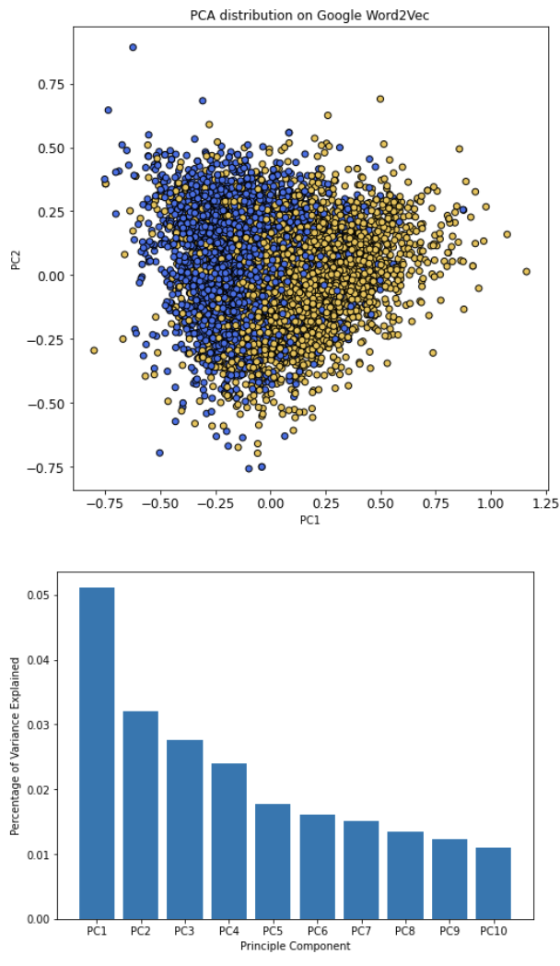
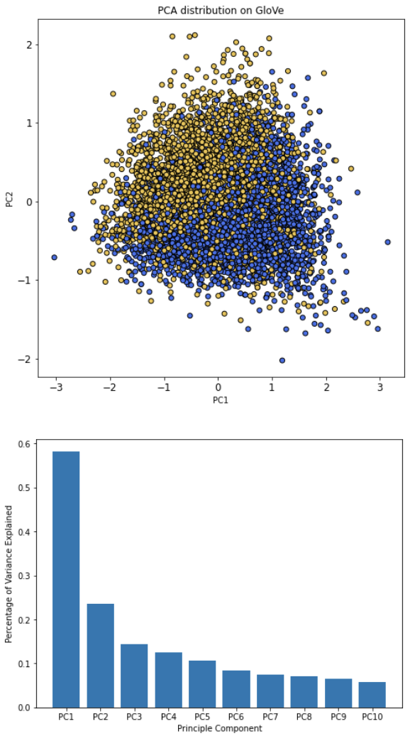
Principal Component Analysis
CountVectorizer
Term Frequency-Inverse Document Frequency
2013 Google Word2Vec
2014 Twitter Global Vectorizer (GloVe)
Convert post to bag of words based on token frequency in the document
Provides the importance of the words in the corpus
Pre-trained embedded vectors on 100 billion words from Google news dataset.
Pre-trained embedded vectors on 2 billion twitter tweets by Stanford University Computer Science Department
Higher number of opposite class in respective class region
Post related to stocks and crypto are very dynamic, the terminology might not have been captured in both Google Word2Vec and Global Vectors.
Expecting better degree of separation compare to word embedding vectors

Slide 15
NLP Modeling
r/stocks and r/CryptoCurrency

Slide 16
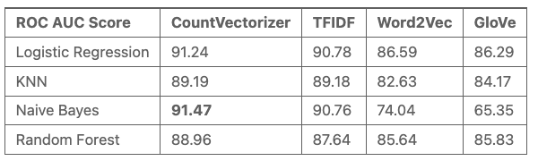
Model Selection
0: r/stocks
1: r/CryptoCurrency
Pre-processed Post
Vectorizer
CountVectorizer
TFIDF
Google Word2Vec
GloVe
Supervised Machine Learning Model (Classifier) based on ROC
Processing time: Naive Bayes is significantly faster than random forest
Naïve Bayes can outperform other algorithms if the feature variables are independent.
Both model are not interpretable, but we can try using Lime Interpreter!

Slide 17
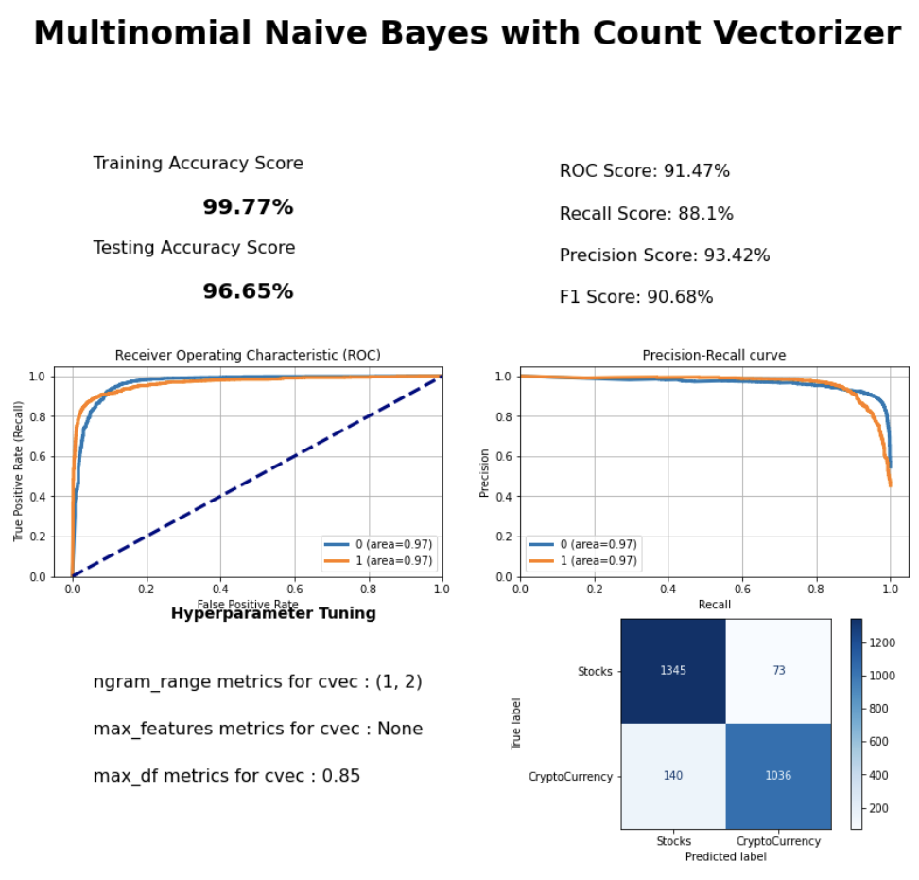
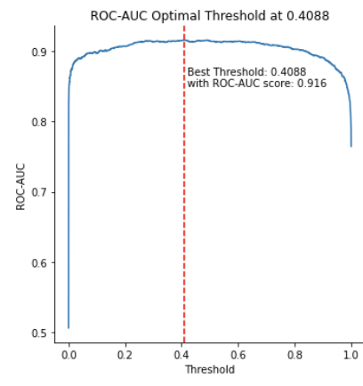
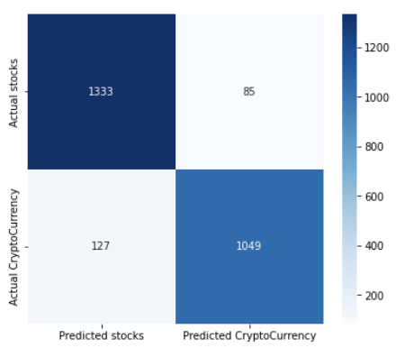
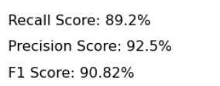
Final Model
0: r/stocks
1: r/CryptoCurrency
Optimal Threshold Selection = 0.4088
Classifier threshold at 0.5: which means <0.5 belongs to stock and above is crypto
There is precision-recall tradeoff observed as the False Negative decreases while the number of False Positive increases.
Comparing with the before and after threshold adjustment, precision 93.42% to 92.5% and recall from 88.1% to 89.2%.

Slide 18
Error Analysis
r/stocks and r/CryptoCurrency

Slide 19
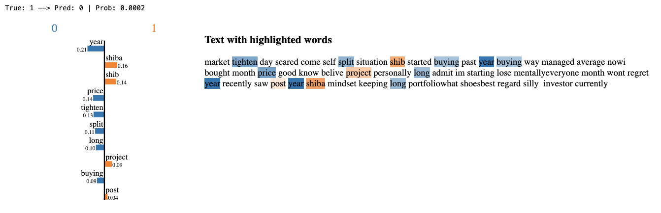
Misclassification: False Negative
0: r/stocks
1: r/CryptoCurrency
Predicting ‘stocks’ subreddit while the true class is ‘CryptoCurrency’
‘stocks’
‘CryptoCurrency’
shiba is actually a good indicator for CryptoCurrency as it is one of the well-known crypto but as we can see there are more features/token corresponding to stocks subreddit instead of cryptocurrency, therefore, model wrongly classified it as stocks instead of CryptoCurrency

Slide 20
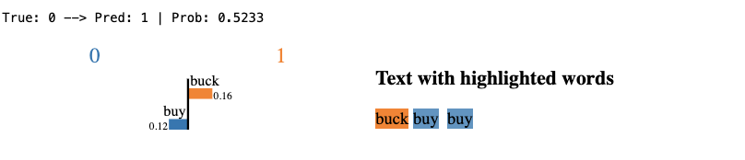
Misclassification: False Positive
0: r/stocks
1: r/CryptoCurrency
Predicting ‘CryptoCurrency’ subreddit while the true class is ‘stocks’
‘stocks’
‘CryptoCurrency’
It is hard to even differentiate for us to classify this post from this post!

Slide 21
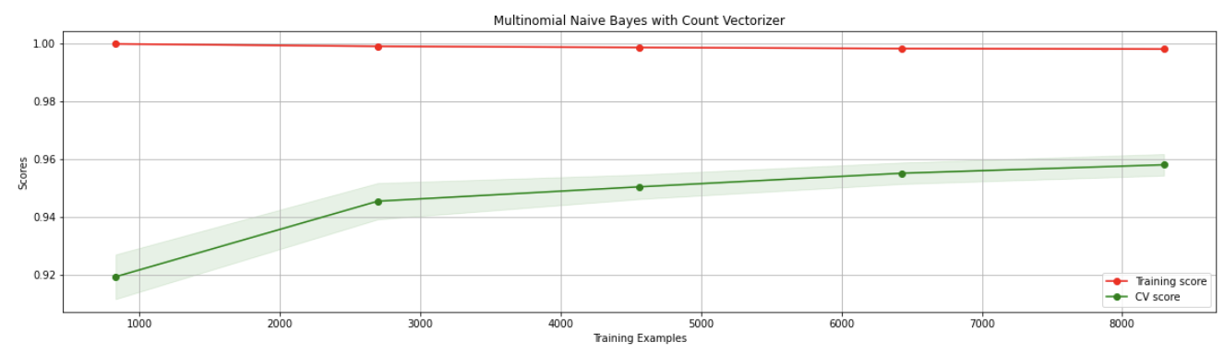
Conclusion
Pre-trained embedded vectors perform worst across all models. This is expected from the first principal component analysis
Across all models, ngram_range = (1,2) is found to be beneficial to increase our accuracy score
There is precision-recall tradeoff observed when we tune our model
If a post contains a lot of vocabulary from the opposite class, our model is unable to predict correctly (False Negative example).
Last but not least, looking at the learning curve plot, we observe our Cross-Validation score has not reached plateau yet, which means we can try to pull more training examples to improve our model score.

